Slide 1
WALLMART SALES ANALSIS
BY Mariyum Baig

Slide 2
Introduction
This project explores Walmart sales data from the Kaggle Walmart Sales Forecasting Competition to uncover key insights into product performance, sales trends, and customer behavior.
The dataset includes sales transactions from three branches containing 17 columns such as invoice details,product information, pricing, customer demographics, and sales metrics
Objectives:
Identify top-performing branches & products
Analyze sales trends
Understand customer behavior
Optimize sales strategies

Slide 3
Data Analysis Approach
Steps followed:
1.Data Wrangling: Handling missing/null value.
2.Feature Engineering: Adding new insights
(e.g., time of day, day name,month name)
3.Exploratory Data Analysis (EDA):
Answering business questions you need it

Slide 4
Feature Engineering
Time of Day (Morning, Afternoon, Evening)
to analyze peak sales hours
Day Name (Mon-Sun)
to find the busiest day ofthe week
Month Name (Jan-Dec)
to determine the highest sales month

Slide 5
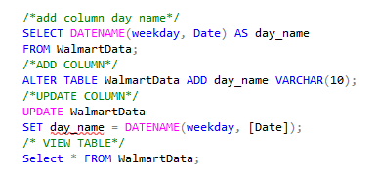
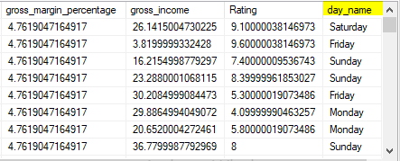
ADD Column : DAY NAME

Slide 6
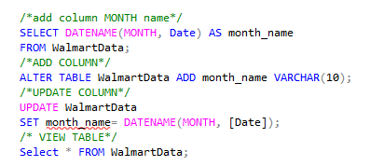
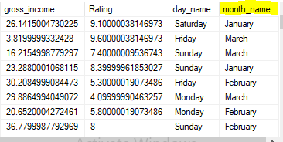
ADD COLUMN :MONTH NAME

Slide 7
Business Questions & Analysis
How many unique cities does the data have?
In which city is each branch?
How many unique product line does the data have?
What product_line had the largest revenue?
What city had the largest revenue?
What product line had the largest VAT?
What is most common payment method?
What is most selling product?
What is revenue by month?
What month had the largest cogs?
Which branch sold more project than average product sold
What is the most common product line by gender?
What is the average ratings for each product line

Slide 8
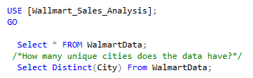
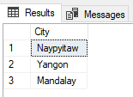
How many unique cities does the data have?

Slide 9

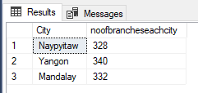
Count no of branches in each city?

Slide 10

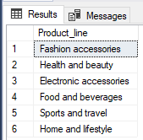
How many unique product line does the data have?

Slide 11

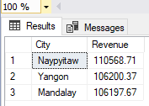
What product_line had the largest revenue??

Slide 12

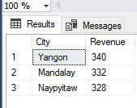
What city had the largest revenue?

Slide 13

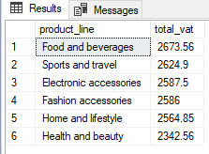
What product line had the largest VAT?

Slide 14

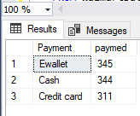
What is most common payment method?

Slide 15

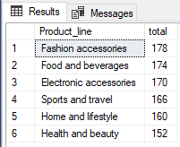
What is most selling product?

Slide 16

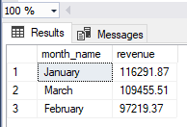
What is revenue by month?

Slide 17

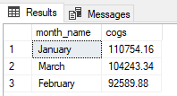
What month had the largest cogs?

Slide 18
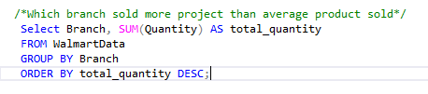
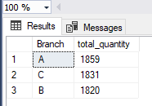
Which branch sold more project than average product sold?

Slide 19
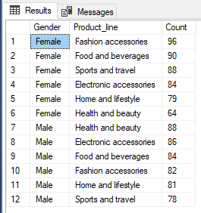
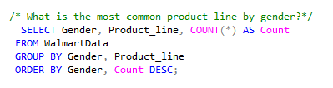
What is the most common product line by gender?

Slide 20
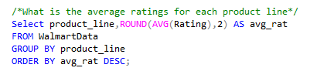
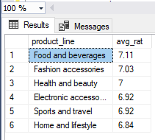
What is the average ratings for each product line?

Slide 21
Thanks
www.linkedin.com/in/mariyum-baig-706128217

